Slide 1
Front End Web Development
Topic 4:
HTML and CSS
Notes:
NCC Education - Title Master

Slide 2
Scope and Coverage
This topic will cover:
DIV element
SPAN element
CSS Selectors
Coding with HTML and CSS
Notes:
NCC Education - Slide Master

Slide 3
Learning Outcomes
By the end of this topic students will be able to:
Explain the concepts of SPAN and DIV element in HTML and CSS
Differentiate between SPAN and DIV element
Identify different type of CSS selectors
Demonstrate the ability to write code for front end web development using HTML and CSS

Slide 4
Unit Roadmap
Week | Topic | Week | Topic
1 | Overview of Web Application Architecture | 7 | JavaScript - II
2 | Introduction to HTML5 | 8 | jQuery
3 | Introduction to CSS | 9 | Responsive CSS Framework: Bootstrap I
4 | HTML and CSS | 10 | Responsive CSS Framework: Bootstrap I
5 | CSS Flexbox and Grid Layout | 11 | Code Review, Testing and Collaboration
6 | JavaScript - I | 12 | Unit Summary

Slide 5
Span and div – HTML/css

Slide 6
What are SPAN and DIV
The <span> and <div> tags are extensively used with CSS
Both are used in a similar fashion, but they serve different purposes
div: A block-level container element.
span: An inline container element.

Slide 7
<DIV> Tag
<div> tag defines logical divisions in the webpage.
Like a paragraph tag, but it divides the page up into larger sections.
<div> allows defining the style of whole sections of HTML
A section of the page can be used as a call out and give that section a different style from the surrounding text

Slide 8
<DIV> Tag
The div element in HTML is a generic container for flow content, which does not inherently represent anything
When styled with CSS, any CSS property can be applied to a div
The div tag doesn't have any "special" properties of its own; it's simply a block-level element by default.

Slide 9
<DIV> Tag
The <div> tag gives you the ability to name certain sections of your documents so that you can affect them with style sheets or Dynamic HTML.
One thing to keep in mind when using the
<div> tag is that it breaks paragraphs. It acts as a paragraph end/beginning, and while you can have paragraphs within a <div> you can't have a <div> inside a paragraph.

Slide 10
Attributes in <div>
The primary attributes of the <div> tag are:
Style
Class
id
<div id="scissors">
<p>This is <strong class="paper"> crazy</strong> </p>
</div>

Slide 11
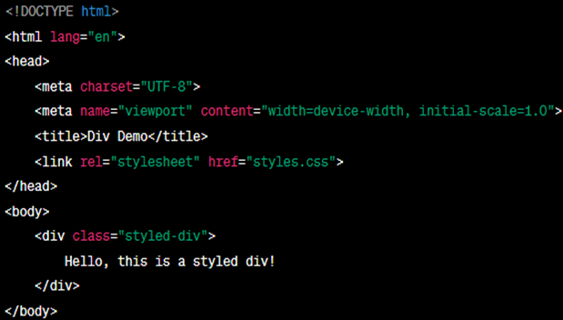
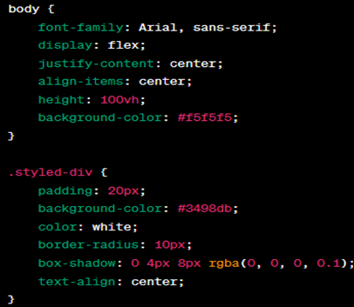
<DIV> Tag

Slide 12
SPAN
The <span> tag has very similar properties to the <div> tag, in that it changes the style of the text it encloses
Without any style attributes, the <span> tag won't change the enclosed items at all.
<div id="scissors">
<p>This is <span class="paper"> crazy</span> </p>
</div>

Slide 13
SPAN vs DIV
The primary difference between the <span> and <div> tags is that <span> doesn't do any formatting of it's own
The <div> tag acts includes a paragraph break, because it is defining a logical division in the document
The <span> tag simply tells the browser to apply the style rules to whatever is within the
<span>
A span element is in-line and usually used for a small chunk of in-line HTML whereas a div (division) element is block-line and used to group larger chunks of code.

Slide 14
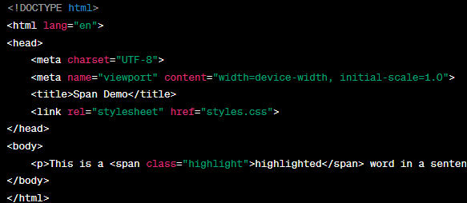
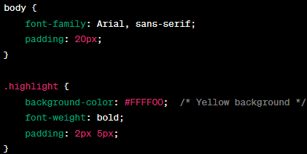
SPAN Element

Slide 15
Css selectors

Slide 16
CSS Selectors
There are 6 types of selectors:
Simple Selector
Class Selector
Generic Selector
Id Selector
Universal Selector
Pseudo Classes

Slide 17
Simple Selector
The Simple Selector form is a single element to which the property and value is applied

Slide 18
Class Selector
Using Class Selector we can assign different styles to the same element.
These different styles appear on different occurrences of that element.

Slide 19
Generic Selector
Defines the class in generalized form
The defined class can be applied to any tag.

Slide 20
ID Selector
Defines a special style for special element
The id Selector is like the Class Selector
Syntax:- #name_of_id{property:value list;}

Slide 21
Universal Selector
This Selector is denoted by “*”
This selector applied to all the elements in the document.

Slide 22
Pseudo Classes
Pseudo classes gives special effects on the selector
Commonly used pseudo classes:
Focus
Hover
Hyperlink
Syntax:- selector:pseudo-class {property:value list;}

Slide 23
Quiz - 1
1. What does the # symbol specify in CSS?
A) A class
B) An ID
C) An element
D) A state
2. Which selector targets all <p> elements inside a <div> element?
A) div p
B) div + p
C) div > p
D) div, p
3. How do you select elements with the class name "example"?
A) #example
B) .example
C) example
D) *example
Notes:
Correct Answer: B) An ID
Correct Answer: A) div p
Correct Answer: B) .example

Slide 24
HTML + css example

Slide 25
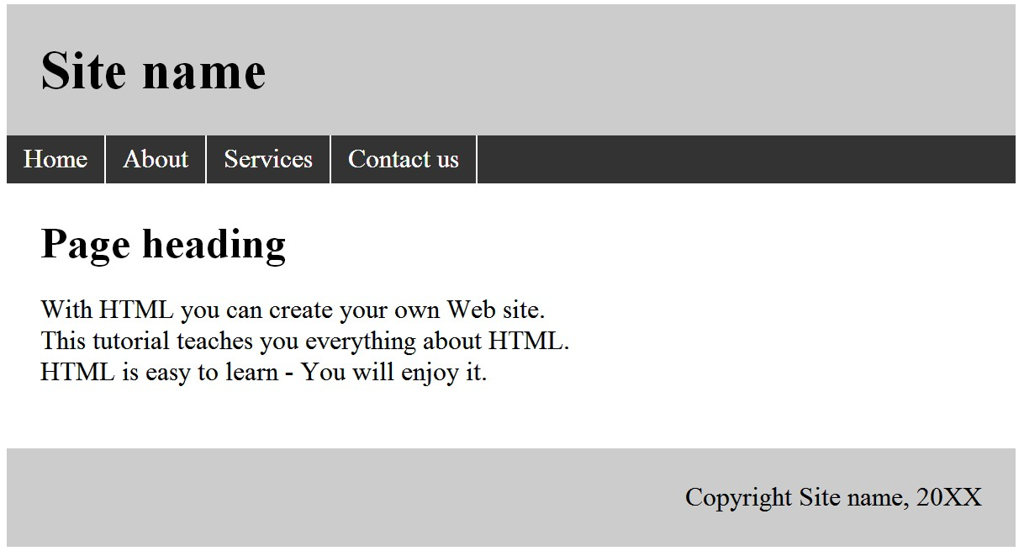
Website Specifications
Goal: Create a website to meet following specification

Slide 26
STEP 1: The site HTML structure
▶ Container
▶ Header
▶ H1
▶ Navigation
▶ ul
▶ Content-container
▶ Content
▶ H2
▶ P
▶ Footer

Slide 27

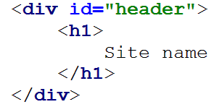
STEP 2: WRITING THE HTML
▶ Header
▶ Code:

Slide 28
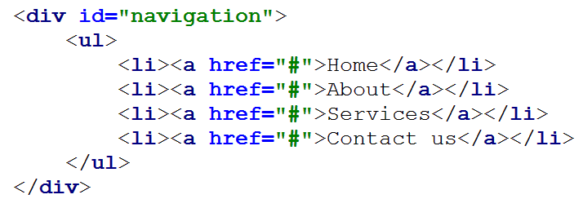
STEP 2: WRITING THE HTML
▶ Navigation
▶ Code:

Slide 29
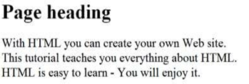
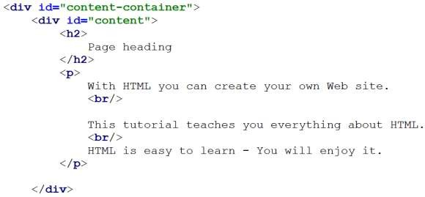
STEP 2: WRITING THE HTML
▶ Content-container
▶ Code:

Slide 30


STEP 2: WRITING THE HTML
▶ Footer
▶ Code:

Slide 31
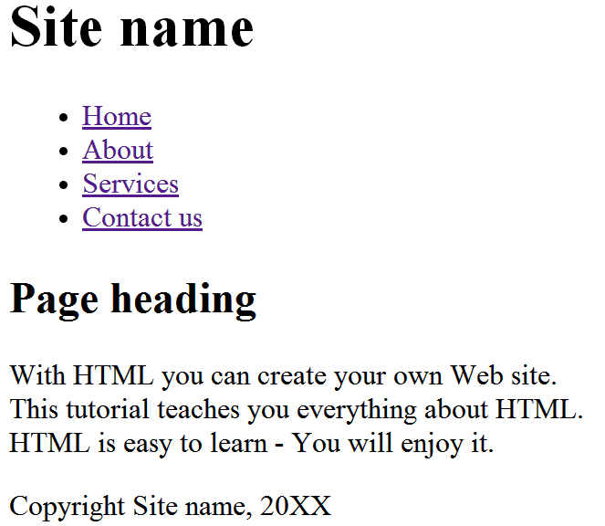
STEP 3: HTML Webpage

Slide 32
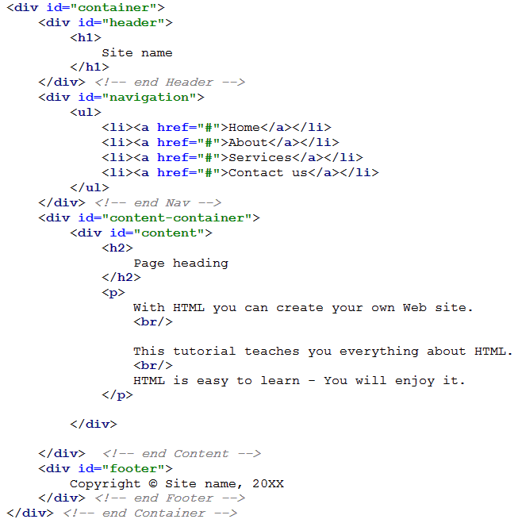
STEP 3: HTML Webpage
▶ Code:

Slide 33
STEP 4: Link CSS with HTML
▶ Code:

Slide 34
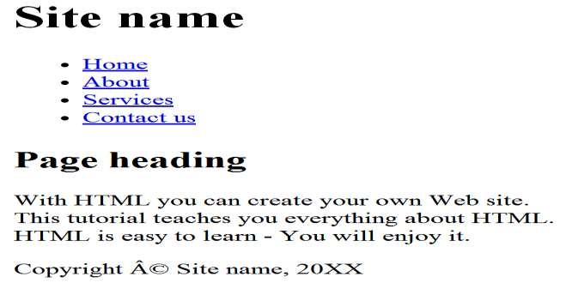
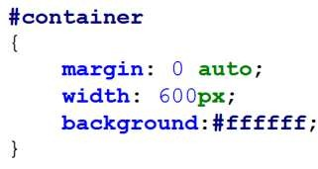
STEP 5: Adding CSS style sheet
▶ Container:
▶ Result:
Code:

Slide 35
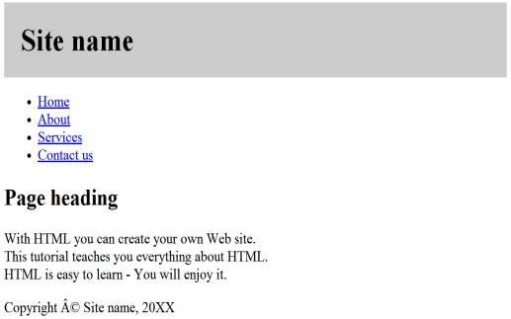
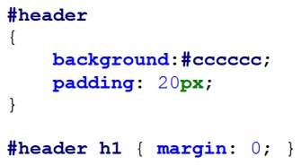
STEP 5: Adding CSS style sheet
▶ Header :
▶ Result:
Code:

Slide 36
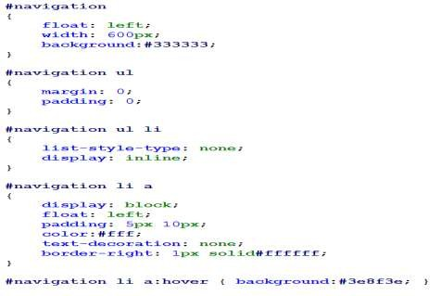
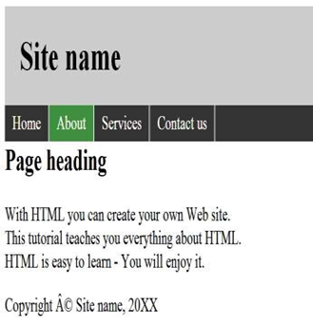
STEP 5: Adding CSS Stylesheet
▶ Header :
▶ Result:
Code:

Slide 37
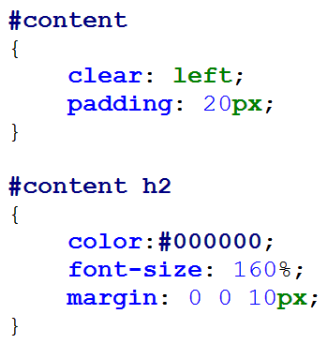
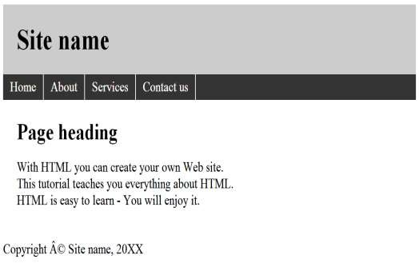
STEP 5: Adding CSS Stylesheet
▶ Content:
▶ Result:
Code:

Slide 38
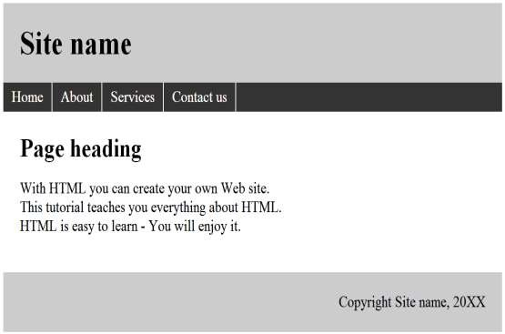
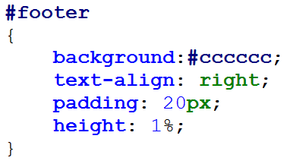
STEP 5: Adding CSS Stylesheet
▶ Footer:
▶ Result:
Code:

Slide 39
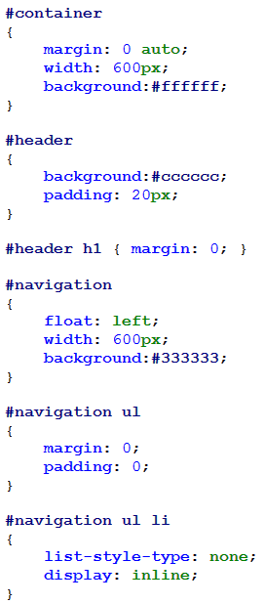
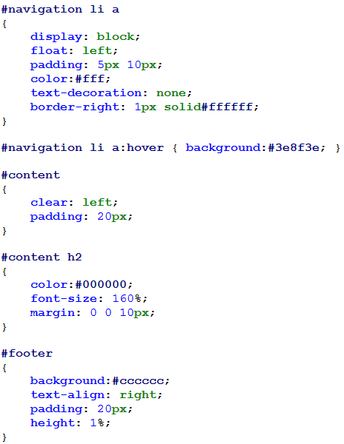
STEP 6: Final CSS File

Slide 40
STEP 7: Website with HTML and CSS

Slide 41
Quiz - 2
1. Which HTML element is used to link an external CSS file?
A) <script>
B) <link>
C) <css>
D) <style>
2. To layout a web page with a header, footer, left sidebar, main content area, and right sidebar, which CSS layout technique could be most effective?
A) Flexbox
B) Floats
C) Position
D) Grid
3. How do you make a background image not repeat in CSS?
A) background-repeat: no-repeat;
B) background-repeat: none;
C) background-no-repeat;
D) background: no-repeat;
Notes:
Correct Answer: B) <link>
Correct Answer: D) Grid
Correct Answer: A) background-repeat: no-repeat;

Slide 42
References
DIV element
Mozilla Developer Network (MDN). (n.d.). <div>: The Content Division element - HTML: HyperText Markup Language. Available at: https://developer.mozilla.org/en-US/docs/Web/HTML/Element/div
Duckett, J. (2011). HTML & CSS: Design and Build Websites. John Wiley & Sons. This book provides a comprehensive guide on HTML and CSS, including the use of <div> elements for structuring content on the web.
SPAN element
Mozilla Developer Network (MDN). (n.d.). <span>: The Content Span element - HTML: HyperText Markup Language. Available at: https://developer.mozilla.org/en-US/docs/Web/HTML/Element/span
FreeCodeCamp. (2021). Span HTML – How to Use the Span Tag with CSS. Available at: https://www.freecodecamp.org/news/span-html-how-to-use-the-span-tag-with-css/
CSS Selectors
Mozilla Developer Network (MDN). (n.d.). CSS Selectors. Available at: https://developer.mozilla.org/en-US/docs/Web/CSS/CSS_Selectors
Meyer, E. A. (2012). CSS: The Definitive Guide. O'Reilly Media. This book covers detailed explanations of CSS selectors among other CSS properties.
Coding with HTML and CSS
Duckett, J. (2011). HTML & CSS: Design and Build Websites. John Wiley & Sons. This book is a beginner-friendly guide that covers the basics of coding with HTML and CSS to build websites.
McFarland, D. (2015). CSS: The Missing Manual. O'Reilly Media. This book provides an in-depth look at CSS and how it can be used in conjunction with HTML to create professional and polished websites.

Slide 43
Topic 4: HTML and CSS
Any Questions?
Notes:
NCC Education - End Slide Master

